Slide 1
HDSC SPRING ‘23 PREMIER PROJECT
PRESENTATION BY TEAM SCIPY

Slide 2
The Team
ACTIVE MEMBERS | ACTIVE MEMBERS
1. Olamide Ayo-Bankole | 5. Immaculate Wakio
2. Agnes Wendi Okello | 6. Oloruntoba Gabriel Irojah
3. Elizabeth Ogunmosu | 7. Okorie Onwuchekwa
4. Musab Moyosore Keshinro
Project Lead: Prince Ogwu
Assistant Project Lead: Nivedha S
Query Analyst: Immanuel Nnaoma Uchendu-Oji
Presenter 1 : Nivedha S
Presenter 2: Mayukh Chakraborti

Slide 3
MUSIC AND MENTAL HEALTH RESULTS
Music is a powerful art form that touches our hearts, stimulates our minds, and enriches our lives. Its ability to communicate emotions, unite people, and provide a means of self-expression makes it an essential part of human culture and a source of joy and inspiration for millions of people worldwide.
Music therapy, or MT, is using music to improve an individual's stress, mood, and overall mental health. MT is also recognized as an evidence-based practice, using music as a catalyst for "happy" hormones such as oxytocin.

Slide 4
AIMS AND OBJECTIVES
The aim of studying the therapeutic effects of music on mental health is to investigate and understand how music can be used as a therapeutic tool to promote psychological well-being, alleviate symptoms of mental disorders, and enhance overall mental health

Slide 5
FLOW PROCESS
The flow chart below illustrates the steps taken:
Data Collection
Data Preparation
Modelling
Training
Model Evaluation

Slide 6
DATA SOURCING/ COLLECTION
In other to carry out this prediction we had to utilize open-source data which was obtained from Kaggle.
Link: https://www.kaggle.com/datasets/catherinerasgaitis/mxmh-survey-results

Slide 7
Brief Description of The Dataset
The dataset contains 736 records and 33 features.
Age: The age of the respondent
Primary streaming service: The streaming service platform the respondent primarily uses for listening to music.
Hours per day: The number of hours per-day the respondent spends listening to music.
While working: indicates whether the respondent listens to music while working.
Instrumentalist: Indicates whether the respondent plays a musical instrument.
Composer: Indicates whether the respondent composes music.
Fav genre: The respondent's favourite genre of music.
Exploratory: Indicates whether the respondent enjoys exploring new genres of music.

Slide 8
Brief Description of the dataset
Foreign languages: Indicates whether the respondent listens to music in foreign languages.
BPM: The average beats per minute of the music the respondent listens to.
Frequency [Classical]: How frequently the respondent listens to classical music.
Frequency [Country]: How frequently the respondent listens to country music.
Frequency [EDM]: How frequently the respondent listens to electronic dance music.
Frequency [Folk]: How frequently the respondent listens to folk music.
Frequency [Gospel]: How frequently the respondent listens to gospel music.
Frequency [Hip hop]: How frequently the respondent listens to hip-hop music.
Frequency [Jazz]: How frequently the respondent listens to jazz music.
Frequency [K pop]: How frequently the respondent listens to K-pop music.
Frequency [Latin]: How frequently the respondent listens to Latin music.

Slide 9
Brief Description of the Dataset
Frequency [Lofi]: How frequently the respondent listens to Lofi music.
Frequency [Metal]: How frequently the respondent listens to metal music.
Frequency [Pop]: How frequently the respondent listens to pop music.
Frequency [R&B]: How frequently the respondent listens to R&B music.
Frequency [Rap]: How frequently the respondent listens to rap music.
Frequency [Rock]: How frequently the respondent listens to rock music.
Frequency [Video game music]: How frequently the respondent listens to video game music.
Anxiety: The level of anxiety the respondent experiences.
Depression: The level of depression the respondent experiences.
Insomnia: The level of insomnia the respondent experiences.
OCD: The level of obsessive-compulsive disorder (OCD) the respondent experiences.
Music effects: The perceived effects of music on the respondent's mental health (e.g., improve, worsen, no effect).
Permissions: Indicates whether the respondent understands and agrees to participate in the study.

Slide 10
DATA PREPARATION

Slide 11
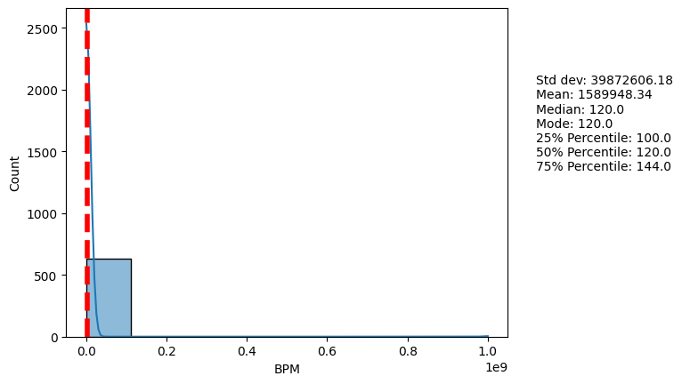
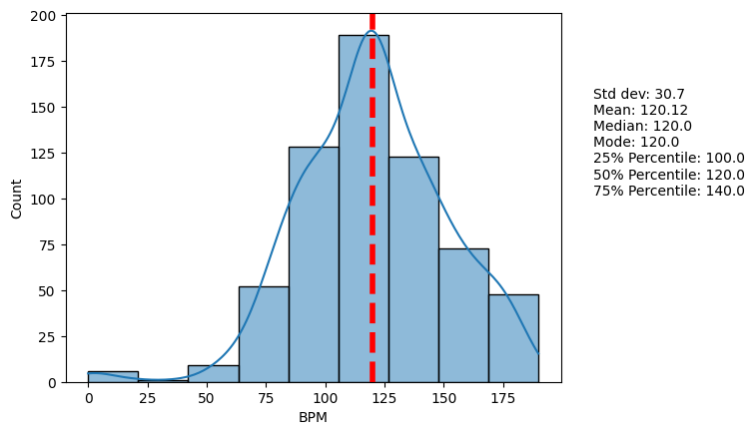
Removing Outliners: This has some nasty outliers that need to be replaced, so by exploring values around the mode and median we can select a suitable threshold to set max values and fill in missing values with the mean.
The following images show the before and after removing the outliers.

Slide 12
Data Cleaning: Here we changed some of the variables so make them shorter and easier to analyze. For example under the primary streaming service column, responses like ‘Other streaming services’ and ‘I do not use a streaming service’ were changed to ‘Other’ and ‘None’
Also some categorical variables were changed to numeric like the responses to how frequently you listen to music; (‘Never’, 'Rarely', 'Sometimes', 'Very frequently') to (0, 1, 2, 3).
Handling Missing Values: Missing values in numeric columns like Age and BPM columns were replaced by the mean. While the categorical values were replaced with the mode.

Slide 13
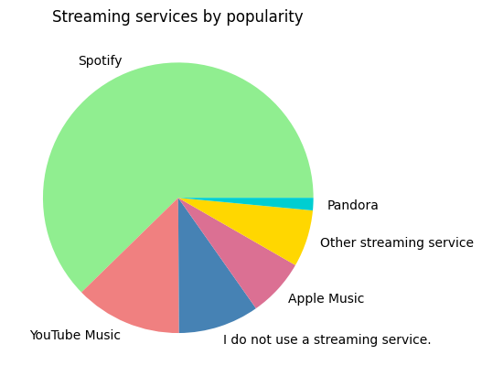
EXPLORATORY DATA ANALYSIS
After data cleaning some visualizations were carried out on the dataset to get some insights about it

Slide 14
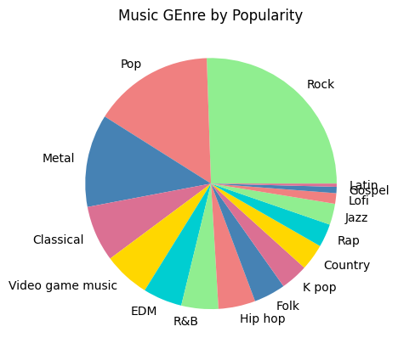
This chart shows that the most popular streaming service used is Spotify by a very large margin.
And the most popular genre is rock.

Slide 15
MODEL
Model Training
Model Evaluation
Model validation

Slide 16
Model Training: The dataset was split into a training dataset and a testing dataset with a split percentage of 80:20. 80% was used to train the data using different regression models. Models used were Logistic Regression, Decision Tree Accuracy, Random Forest Accuracy, KNN, SVM and Neural Network.
2. Model Evaluation: The evaluation metric used is sklearn accuracy score since this is a categorization problem and the results is as follows: Logistic Regression Accuracy: 0.7837837837837838, Decision Tree Accuracy: 0.5675675675675675, Random Forest Accuracy: 0.7702702702702703, KNN Accuracy: 0.75, SVM Accuracy: 0.7635135135135135,NN Accuracy: 0.7432432432432432

Slide 17
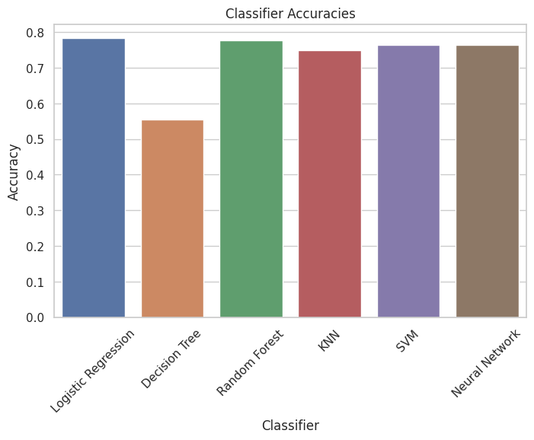
3. Logistic Regression has the highest accuracy

Slide 18
RESULTS, CONCLUSION AND RECOMMENDATION
Hyper-parameter tuning can improve results, for example, adjusting the Max BPM feature down from 200 to 190 resulted in an increase in model accuracy from 77 to 78 % for logistic regression as well as slight improvements in other models, also more training data. When we increased training data to 90:10 split, accuracy went to 80% for example.

